Slide 1



M/s. Mother India Life Spaces and Infra Engineering Limited, INDIA.
(Deals in Exports: All Agricultural Food Products, FMCG., Construction Materials)
The Reverse Buyer – Seller Meet (RBSM),
‘B to B’ assembling with
M/s. Jack Maddison Holdings - South Africa
(Deals in Imports: Food Products, & Juices, Agri & Processed Food, Construction Materials)
On dated: 19.02.2025, (Wednesday), 11.00 AM – 11.15 AM
At: Venue: Hotel Radisson Blu Resorts, Visakhapatnam.

Slide 2
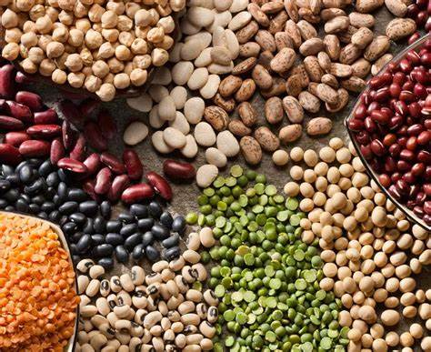
1. Pulses
A Rich Source of Protein & Nutrition
Pulses are edible seeds of plants in the legume family. They are a rich source of protein, fiber, vitamins, and minerals, making them an essential part of a healthy diet. Pulses are low in fat and cholesterol-free, making them ideal for heart health and weight management. They are also a great plant-based protein source, commonly used in vegetarian and vegan diets.
Lentils (Masoor, Moong, Urad, Toor, Chana) – Quick-cooking and rich in protein.
Chickpeas (Kabuli Chana, Desi Chana) – High in fiber and used in a variety of dishes.
Peas (Green Peas, Split Yellow Peas) – Good for soups, stews, and curries.
Beans (Rajma, Black Beans, Soybeans, Navy Beans, Fava Beans) – Packed with protein and essential nutrients.
High in protein and fiber
Low in fat and cholesterol-free
Rich in iron, potassium, and folate
Helps in digestion and weight management
Types of Pulses:
Nutritional Benefits:

Slide 3
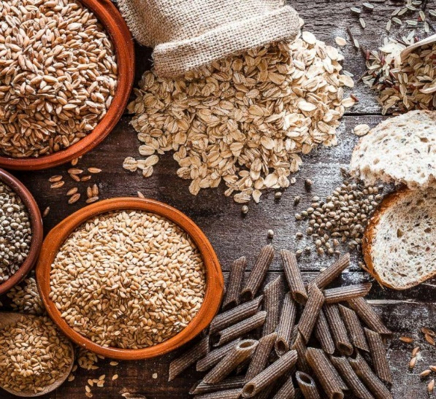

2. Grains
Grains are the heart of a healthy diet
Grains are small, hard, edible seeds of cereal plants that form a major part of human diets worldwide. They are a rich source of carbohydrates, fiber, protein, and essential nutrients, making them a staple food in many cultures. Grains provide energy and contribute to overall health and well-being.
Whole Grains – Contain the entire grain kernel (bran, germ, and endosperm), making them highly nutritious. Examples:
  Wheat (Whole wheat, bulgur)
  Rice (Brown rice, red rice, black rice)
  Oats
  Quinoa
  Barley
  Millets (Ragi, Bajra, Jowar)
Refined Grains – Processed to remove the bran and germ, resulting in a finer texture but lower nutritional value. Examples:
  White Rice
  White Flour (Maida)
  Cornstarch
Types of Grains:
Nutritional Benefits:
Rich in carbohydrates for energy.
High in fiber, aiding digestion and weight management.
Good source of B vitamins, iron, and magnesium.
Helps lower cholesterol and maintain heart health.

Slide 4
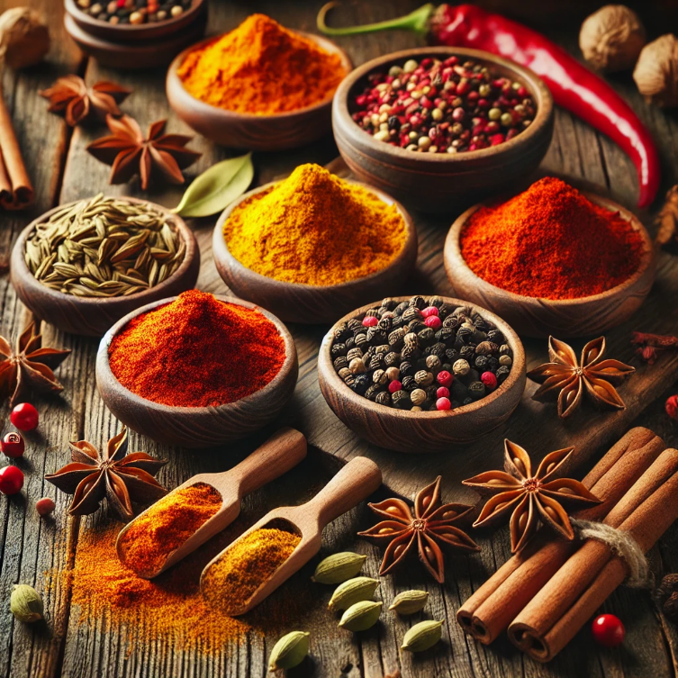
3. Spices
Spices are the secret to turning simple meals into extraordinary flavors!
Spices are dried plant parts such as seeds, roots, bark, or fruits used to enhance the flavor, aroma, and color of food. They have been an integral part of culinary traditions worldwide and are also known for their medicinal and preservative properties.
Types of Spices:
Whole Spices:
  Cardamom – Sweet and aromatic, used in desserts and teas.
  Cloves – Strong, warm spice used in curries and masalas.
  Cinnamon – Sweet and woody, enhances baked goods and beverages.
  Black Pepper – Pungent and spicy, adds heat to dishes.
  Cumin Seeds – Earthy and nutty, commonly used in Indian and Middle Eastern cuisine.
  Mustard Seeds – Sharp and tangy, used in pickles and tempering.
  Bay Leaves – Aromatic leaves used in stews and rice dishes.
Spice Powders:
  Turmeric Powder – Bright yellow with anti-inflammatory properties.
  Chili Powder – Adds heat and spice to food.
  Coriander Powder – Earthy and citrusy, used in curries and marinades.
  Cumin Powder – Enhances depth and aroma in various cuisines.
  Garam Masala – A blend of multiple spices, adding warmth to Indian dishes.
  Black Pepper Powder – Used for seasoning and medicinal benefits.

Slide 5
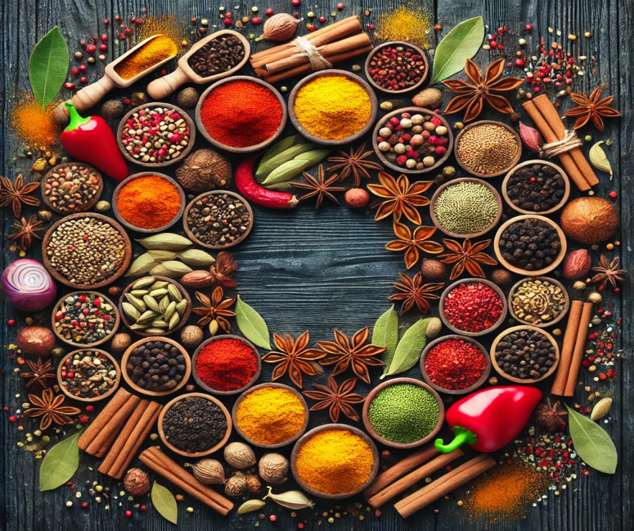
Health Benefits of Spices:
Rich in antioxidants and anti-inflammatory compounds.
Aids digestion and boosts metabolism.
Helps improve immunity and overall health.
Spices and spice powders are essential in global cuisines, from Indian and Middle Eastern dishes to European and Asian flavors. They add depth and complexity to food while offering numerous health benefits.

Slide 6
4. Spice powders
Transforming every dish into a masterpiece!
Spice powders are finely ground forms of whole spices used to enhance the taste, aroma, and color of food. They are an essential part of cooking in various cuisines worldwide, adding depth and complexity to dishes. These powders not only improve flavor but also offer several health benefits.
Types of Spice Powders & Their Uses:
Turmeric Powder (Haldi) – Bright yellow with earthy flavor; used for color and health benefits.
Chili Powder (Lal Mirch) – Adds heat and spice; available in mild to extra hot varieties.
Coriander Powder (Dhania Powder) – Mildly citrusy and earthy; used in curries, marinades, and soups.
Cumin Powder (Jeera Powder) – Warm and slightly nutty; enhances Indian and Middle Eastern dishes.

Slide 7
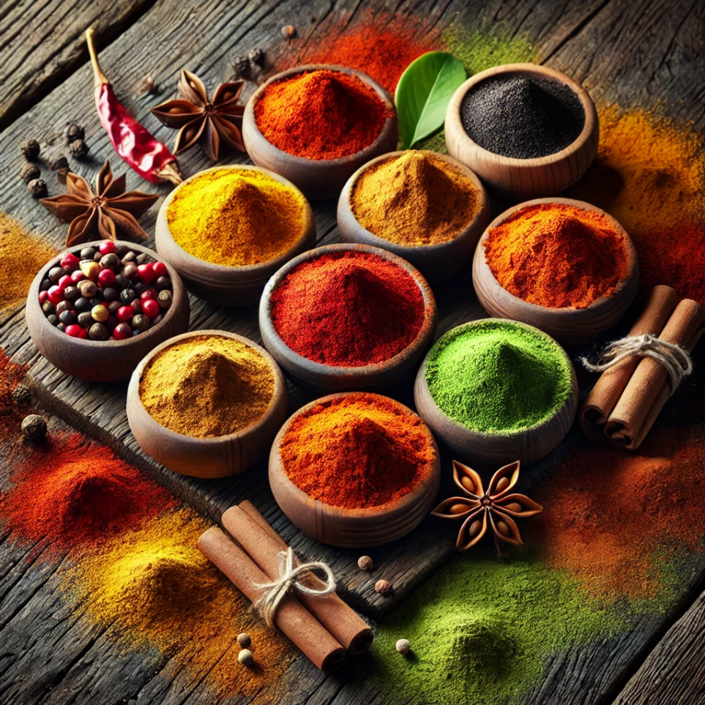
Garam Masala – A blend of several ground spices like cinnamon, cloves, and cardamom; adds warmth and aroma.
Black Pepper Powder (Kali Mirch Powder) – Pungent and spicy; used for seasoning and medicinal purposes.
Fenugreek Powder (Methi Powder) – Slightly bitter; enhances curries and spice blends.
Ginger Powder (Sonth) – Strong and warm; used in teas, desserts, and Ayurvedic remedies.
Cinnamon Powder (Dalchini Powder) – Sweet and woody; perfect for desserts and spicy curries.
Fennel Powder (Saunf Powder) – Sweet and aromatic; used in spice blends and digestive teas.

Slide 8
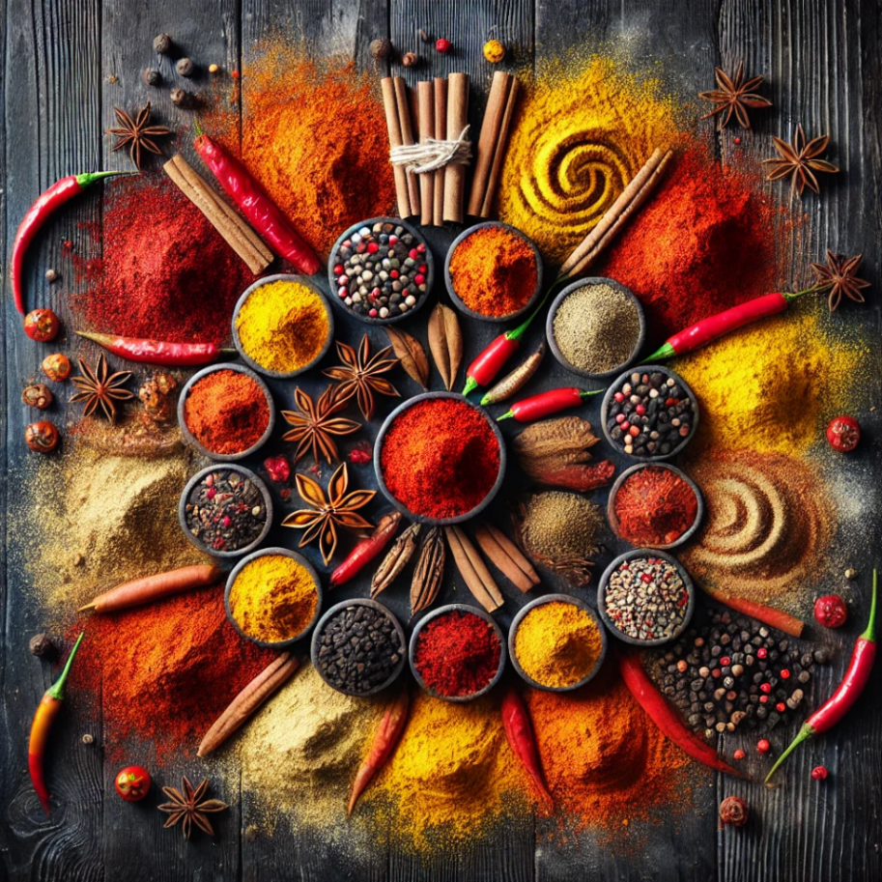
Health Benefits of Spice Powders:
Rich in antioxidants and anti-inflammatory properties
Helps in digestion and boosts metabolism
Enhances immunity and overall well-being
Adds natural flavor without extra calories or artificial additives
Spice powders are a staple in every kitchen, bringing out the best flavors in food while offering

Slide 9
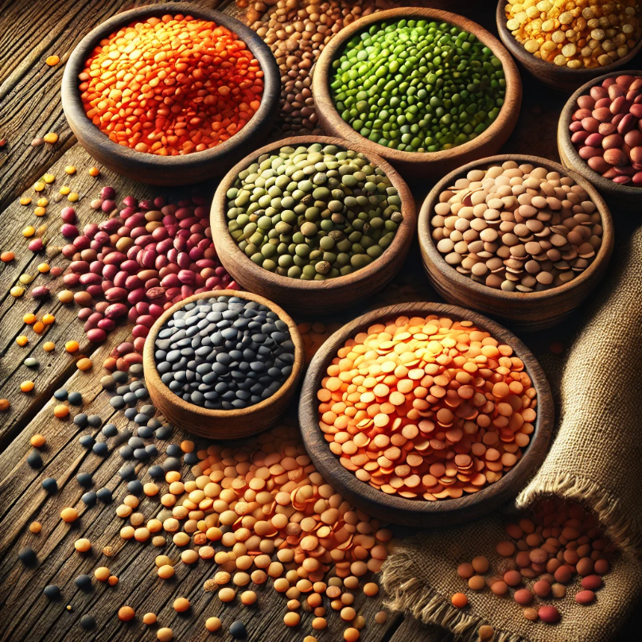
5. Lentils
Lentils are a powerhouse of protein, nutrition
Lentils are small, lens-shaped edible legumes that are a rich source of protein, fiber, and essential nutrients. They are widely used in various cuisines around the world, especially in Indian, Middle Eastern, and Mediterranean dishes. Lentils are easy to cook, highly nutritious, and available in different colors and varieties.
Types of Lentils:
Red Lentils (Masoor Dal) – Soft and quick-cooking; used in soups and dal.
Green Lentils – Firm texture; great for salads and stews.
Brown Lentils – Earthy flavor; used in curries and casseroles.
Black Lentils (Urad Dal) – Rich and creamy; used in dal makhani.
Yellow Lentils (Moong Dal, Toor Dal) – Light and easy to digest; used in Indian dishes.

Slide 10


Nutritional Benefits:
High in Protein – Excellent plant-based protein source.
Rich in Fiber – Supports digestion and gut health.
Loaded with Iron & Folate – Helps in energy production and cell growth.
Low in Fat & Calories – Aids in weight
management.
Lentils are easy to prepare, requiring minimal soaking and a short cooking time.
They are commonly used in soups, stews, curries, and salads, making them a staple in healthy diets worldwide.

Slide 11
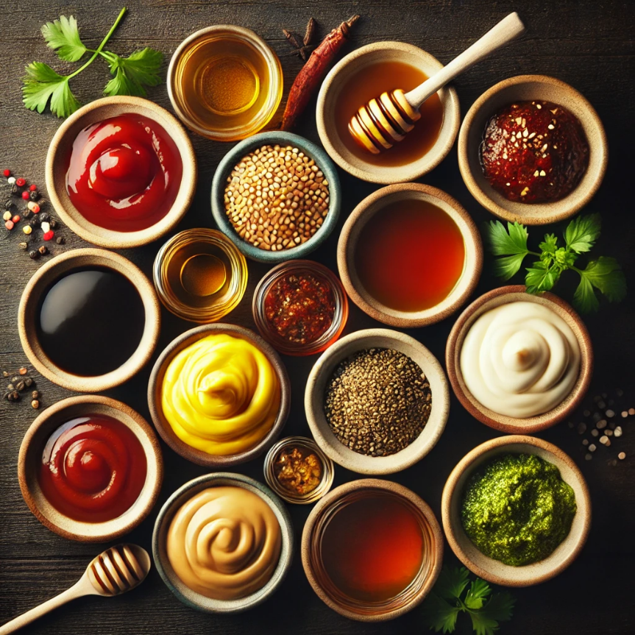
6. Condiments
The finishing touch that take flavors to the next level!
Condiments are sauces, spreads, or seasonings added to food to enhance its flavor, texture, or appearance. They can be spicy, tangy, sweet, or savory, depending on the ingredients used. Condiments are widely used in global cuisines, making dishes more flavorful and enjoyable.
Types of Condiments:
1. Sauces & Pastes:
Tomato Ketchup – Sweet and tangy, commonly used with snacks and fast food.
Mayonnaise – Creamy and rich, used in sandwiches, salads, and dips.
Soy Sauce – Salty and umami-rich, essential in Asian cooking.
Mustard – Spicy and tangy, enhances burgers and sandwiches.
Chili Sauce – Hot and spicy, adds a kick to various dishes.
Barbecue Sauce – Smoky and slightly sweet, perfect for grilled foods.

Slide 12
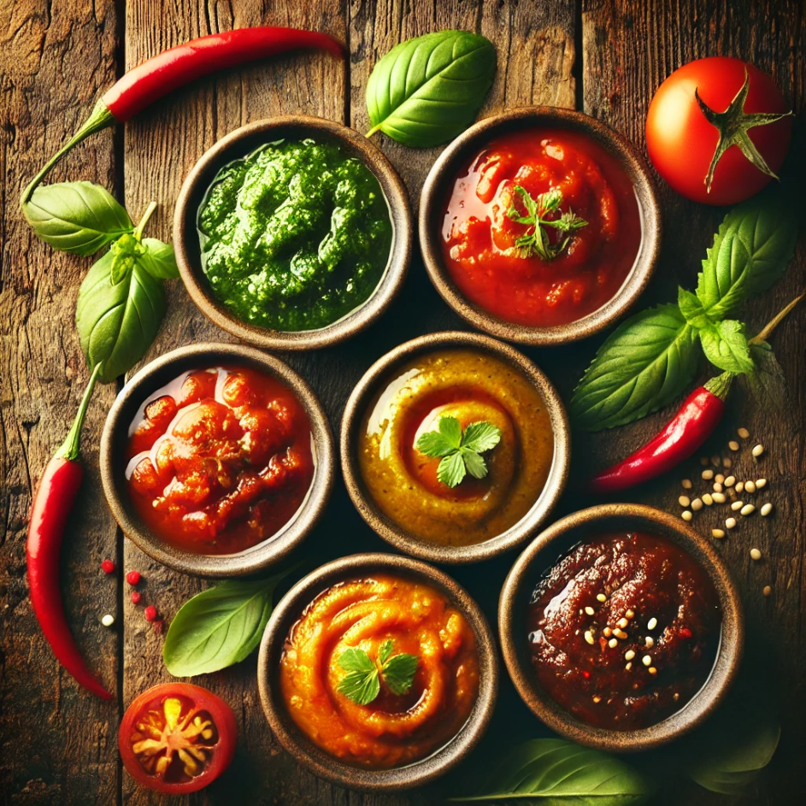
2. Spice & Herb-Based Condiments:
Chutneys (Mint, Tamarind, Coconut, Mango) – Common in Indian cuisine for dipping and flavor enhancement.
Pickles (Achar) – Preserved vegetables or fruits with spices, offering a tangy and spicy taste.
Horseradish & Wasabi – Strong and pungent, used in Japanese and European dishes.
Pesto – Basil-based Italian condiment, used in pasta and sandwiches.

Slide 13
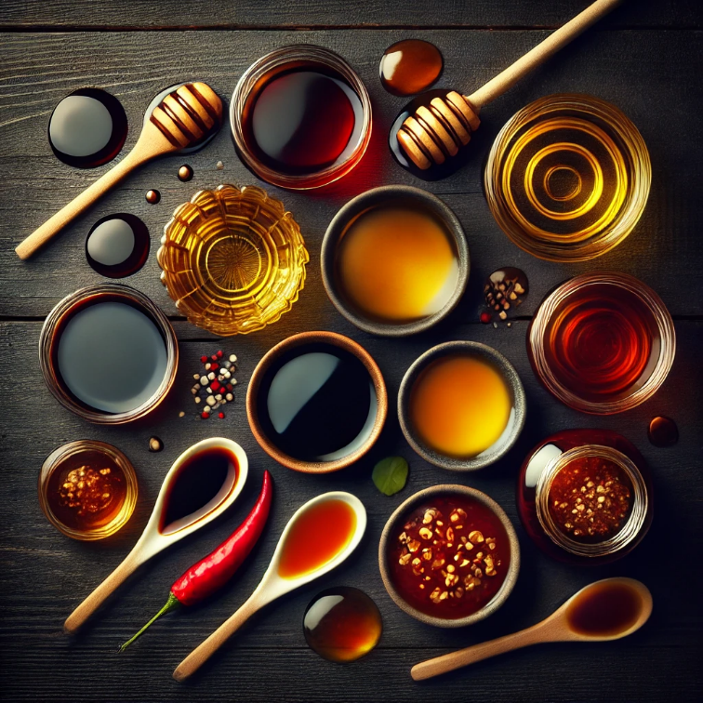
3. Liquid Condiments:
Vinegar (Apple Cider, White, Balsamic) – Used in dressings, marinades, and pickling.
Hot Sauce (Tabasco, Sriracha) – Spicy and tangy, enhances various cuisines.
Fish Sauce – Salty and umami-rich, widely used in Southeast Asian cooking.
Honey & Maple Syrup – Natural sweeteners, used in cooking and dressing.
Benefits of Condiments:
Enhance taste and texture of food.
Add variety and uniqueness to dishes.
Some condiments, like fermented sauces, provide probiotics for gut health.
Used in small quantities, they elevate the overall dining experience.
Condiments are an essential part of global cuisines, offering unique flavors and complementing different foods. Whether spicy, sweet, or tangy, they make meals more enjoyable!

Slide 14
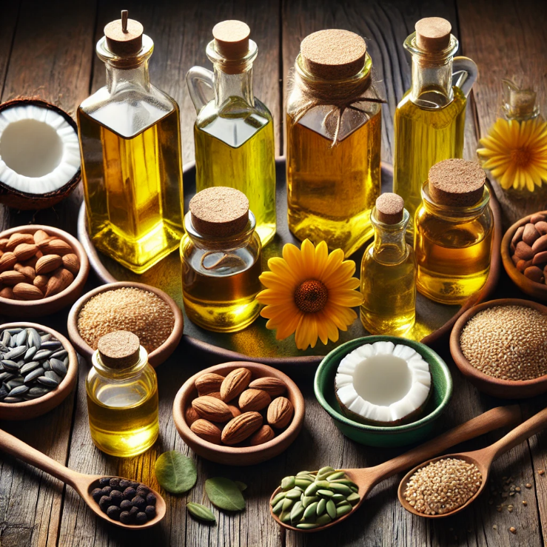
7. Oils
Essential Cooking and Nutritional Ingredient
Oils are fats extracted from seeds, nuts, or fruits and are widely used for cooking, frying, dressing, and even medicinal purposes. They enhance flavour, provide essential fatty acids, and are a key source of energy. Different types of oils have unique health benefits and uses in various cuisines.
Types of Cooking Oils & Their Uses:
Vegetable & Seed Oils:
Sunflower Oil – Light and mild, ideal for frying and deep-frying.
Soybean Oil – Rich in Omega-3, used for general cooking.
Canola Oil – Low in saturated fats, great for baking and stir-frying.
Corn Oil – High smoke point, commonly used for frying.
Sesame Oil – Aromatic and nutty, popular in Asian cuisine.
Mustard Oil – Strong and pungent, used in Indian and Bengali dishes.

Slide 15

Nut & Fruit Oils:
Coconut Oil – Solid at room temperature, used in South Indian cooking and skincare.
Olive Oil (Extra Virgin, Pure, Light) – Healthy and versatile, great for salads and low-heat cooking.
Peanut Oil – Nutty flavor, excellent for deep-frying and Asian cooking.
Almond Oil – Used for dressings, desserts, and skin care.
Specialty & Health Oils:
Flaxseed Oil – Rich in Omega-3, best used raw in salads.
Avocado Oil – High in monounsaturated fats, great for cooking and dressings.
Ghee (Clarified Butter) – Common in Indian cuisine, provides a rich aroma and taste.
Health Benefits of Oils:
Provide essential fatty acids for brain and heart health.
Improve nutrient absorption of fat-soluble vitamins (A, D, E, K).
Support skin and hair health.
Some oils (olive, flaxseed) have anti-inflammatory properties.

Slide 16
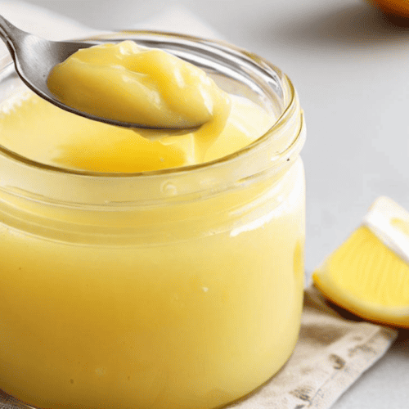
8. Vegetable Ghee
A Dairy-Free Alternative to Traditional Ghee
Vegetable ghee, also known as vanaspati ghee, is a plant-based alternative to traditional dairy ghee. It is made by hydrogenating vegetable oils, giving it a solid texture and a buttery flavor. It is widely used in Indian, Middle Eastern, and Asian cuisines for cooking, frying, and baking.
Characteristics of Vegetable Ghee:
Dairy-Free & Vegan-Friendly – Suitable for people who avoid animal products.
Rich Texture & Buttery Aroma – Mimics the taste of traditional ghee.
Long Shelf Life – Does not spoil easily and remains stable at room temperature.
High Smoke Point – Ideal for deep-frying, roasting, and sautéing.

Slide 17
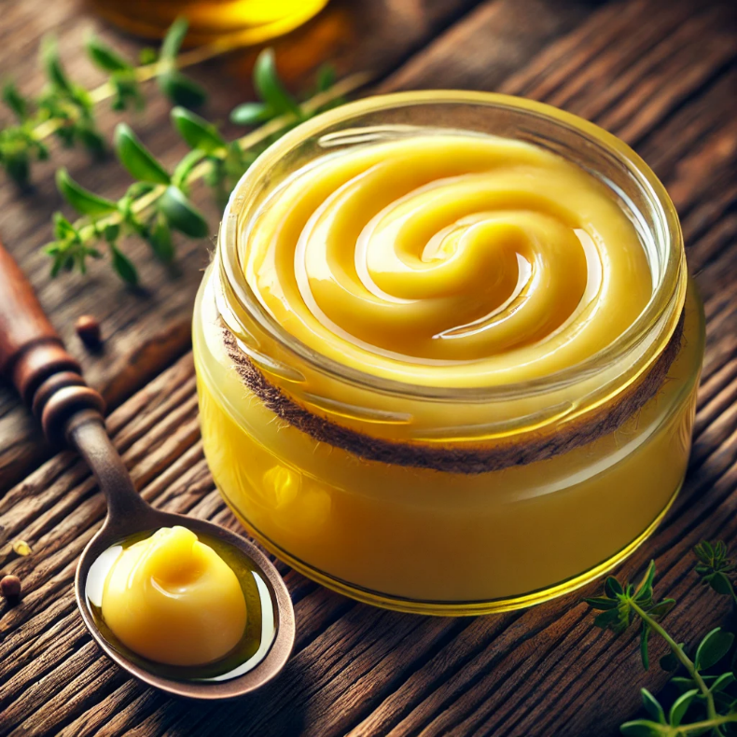
Uses of Vegetable Ghee:
Cooking and frying traditional dishes.
Used in baking sweets and confectionery.
Common in making parathas, curries, and biryanis.
Adds richness to desserts like halwa and ladoos.
Health Aspects:
Contains trans fats, which may not be heart-healthy.
Provides instant energy like traditional ghee.
Should be consumed in moderation for balanced nutrition.
Vegetable ghee is a cost-effective and versatile cooking fat, but for better health, it's advisable to choose trans fat-free or minimally processed alternatives.

Slide 18
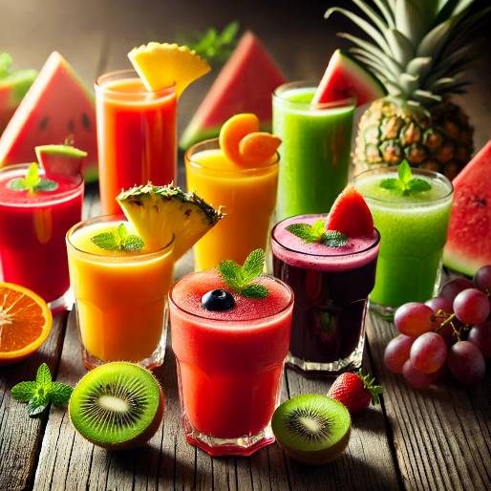
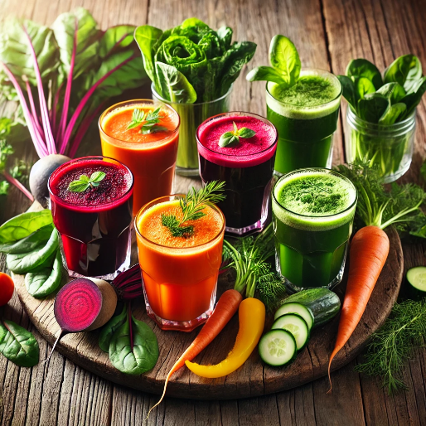
9. Juices
Refreshing and Nutritious Beverages
Juices are liquid extracts from fruits, vegetables, or herbs, offering a delicious and refreshing way to consume essential vitamins and minerals. They can be freshly squeezed, cold-pressed, or commercially processed, providing hydration and health benefits.
Types of Juices & Their Benefits:
Fruit Juices:
Orange Juice – Rich in vitamin C, boosts immunity.
Apple Juice – Aids digestion and promotes heart health.
Pomegranate Juice – High in antioxidants, supports blood circulation.
Mango Juice – Energizing and loaded with vitamins A and C.
Pineapple Juice – Aids digestion and has anti-inflammatory properties.
Watermelon Juice – Hydrating and refreshing, great for summer.
Grape Juice – Contains antioxidants, supports heart health.
Vegetable Juices:
Carrot Juice – High in beta-carotene for eye and skin health.
Beetroot Juice – Improves blood flow and stamina.
Tomato Juice – Rich in lycopene, good for heart health.
Spinach & Green Juice – Detoxifying, packed with iron and fiber.

Slide 19
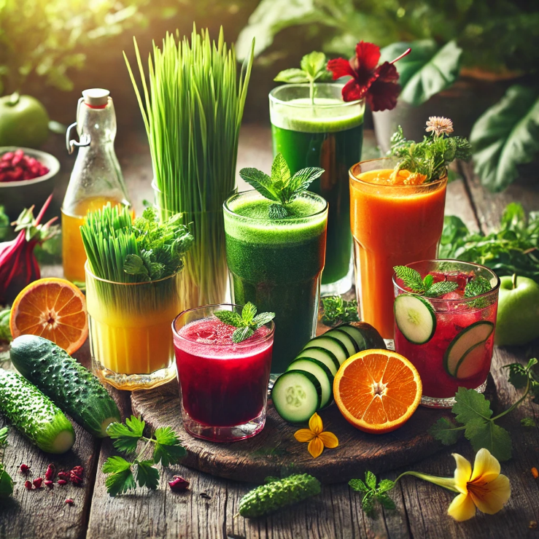
Herbal & Mixed Juices:
Aloe Vera Juice – Supports digestion and skin health.
Lemon & Ginger Juice – Boosts metabolism and immunity.
Coconut Water – Naturally hydrating with electrolytes.
Health Benefits of Juices:
Provide essential vitamins and minerals.
Help in hydration and detoxification.
Support digestion and immunity.
Fresh juices are natural energy boosters.
While fresh juices are healthy, packaged juices may contain added sugars and preservatives. Opting for fresh, homemade juices ensures maximum nutrition and health benefits!

Slide 20

10. Soft Drinks
Refreshing Carbonated Beverages
Soft drinks are non-alcoholic, carbonated beverages that are sweetened and flavoured to provide a refreshing taste. They are widely consumed worldwide and come in various Flavors, including cola, citrus, and fruit-based options.
Types of Soft Drinks:
1. Cola-Based Soft Drinks:
Classic carbonated beverages with caffeine and caramel flavor.
Examples: Coca-Cola, Pepsi, Thums Up.
2. Citrus-Flavored Soft Drinks:
Tangy and refreshing, made with lemon, lime, or orange flavors.
Examples: Sprite, 7UP, Fanta, Mountain Dew.
3. Fruit-Flavored Soft Drinks:
Infused with artificial or natural fruit flavors.
Examples: Mirinda (Orange), Slice (Mango), Maaza (Mango).
4. Tonic Water & Soda Water:
Carbonated water with minerals, sometimes with added quinine for a bitter taste.
Used as a mixer in cocktails or consumed plain.
5. Diet & Sugar-Free Soft Drinks:
Low or zero-calorie versions with artificial sweeteners.
Examples: Diet Coke, Pepsi Zero Sugar.

Slide 21
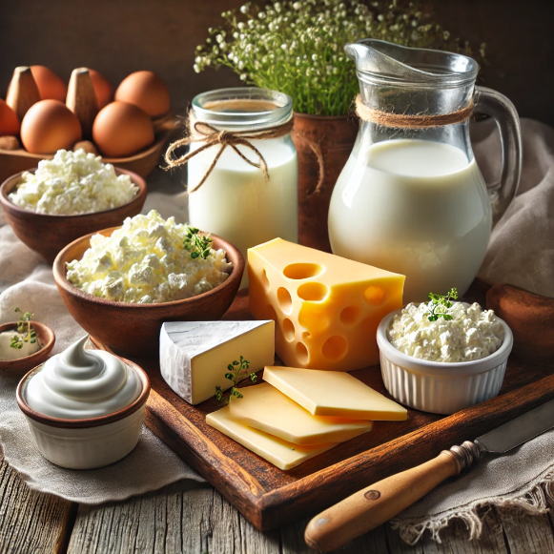
11. Dairy Products
Essential Nutrients for a Healthy Lifestyle
Dairy products are foods made from milk, providing essential nutrients like calcium, protein, and vitamins. They are widely consumed worldwide and used in cooking, beverages, and desserts. Dairy is derived from cow, buffalo, goat, or sheep milk and plays a crucial role in maintaining bone health and overall nutrition.
1. Milk
A rich source of calcium, protein, and vitamin D.
Consumed directly or used in cooking, coffee, and tea.
Available in whole, skimmed, toned, or plant-based alternatives (almond, soy, oat milk).
2. Butter
Made by churning cream or milk; used in cooking, baking, and spreading.
Provides healthy fats but should be consumed in moderation.
3. Cheese
Aged or fresh dairy product made from milk solids.
Types: Cheddar, Mozzarella, Parmesan, Cottage Cheese (Paneer), Blue Cheese.
Rich in protein and calcium but varies in fat content.
Types of Dairy Products & Their Benefits:

Slide 22


4. Yogurt (Curd/Dahi)
Fermented dairy product with probiotics for gut health.
Available in plain, flavored, Greek yogurt, and probiotic versions.
5. Ghee (Clarified Butter)
Used in Indian and Middle Eastern cuisines.
Provides good fats and aids digestion.
6. Cream & Whipping Cream
High-fat dairy product used in desserts, sauces, and soups.
Variants include heavy cream, fresh cream, and sour cream.
7. Ice Cream & Dairy Desserts
Made from milk, cream, and sugar with various flavors.
Includes frozen yogurt, custard, and puddings.
Strengthens bones and teeth with calcium and vitamin D.
Provides high-quality protein for muscle growth.
Supports gut health with probiotic-rich yogurt.
Aids energy and metabolism with essential vitamins.
While dairy is highly nutritious, lactose-intolerant individuals can opt for plant-based alternatives like almond, soy, or coconut milk.
Health Benefits of Dairy Products:

Slide 23
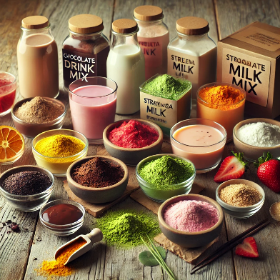
12. Powdered Drink Mixes
Instant Refreshment Anytime
Powdered drink mixes are dehydrated beverage powders that can be easily mixed with water or milk to create refreshing and flavourful drinks. They come in various Flavors and types, offering convenience and a long shelf life. These mixes are popular for instant energy, hydration, and taste enhancement.
1. Fruit-Flavored Drink Mixes
Made with artificial or natural fruit Flavors like orange, mango, lemon, and pineapple.
Examples: Tang, Rasna, Kool-Aid.
2. Energy & Sports Drink Mixes
Contains electrolytes, vitamins, and minerals to boost energy and replenish hydration.
Examples: Gatorade powder, ORS (Oral Rehydration Solution), Glucon-D.
3. Chocolate & Malt-Based Drink Mixes
Fortified with vitamins and minerals, often mixed with milk.
Examples: Bourn Vita, Horlicks, Boost, Milo.
Enhances growth, strength, and bone health, especially for kids.
Types of Powdered Drink Mixes:

Slide 24
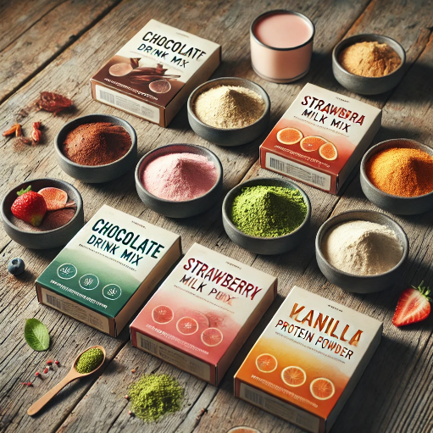

4. Protein & Health Supplement Powders
High-protein powders for fitness and muscle-building.
Examples: Whey protein, casein protein, and plant-based protein powders.
Supports muscle recovery and overall nutrition.
5. Coffee & Tea-Based Mixes
Instant coffee and tea powders for quick preparation.
Examples: Nescafé instant coffee, Bru coffee, premixed masala chai.
Convenient for making hot or cold beverages.
Benefits of Powdered Drink Mixes:
Easy to prepare – Just mix with water or milk.
Long shelf life – Can be stored for months.
Variety of Flavors – Offers a wide range of choices.
Fortified with nutrients – Some contain added vitamins & minerals.
While convenient, some powdered drink mixes may contain added sugars and artificial Flavors, so it’s best to choose healthier or natural options when possible.

Slide 25
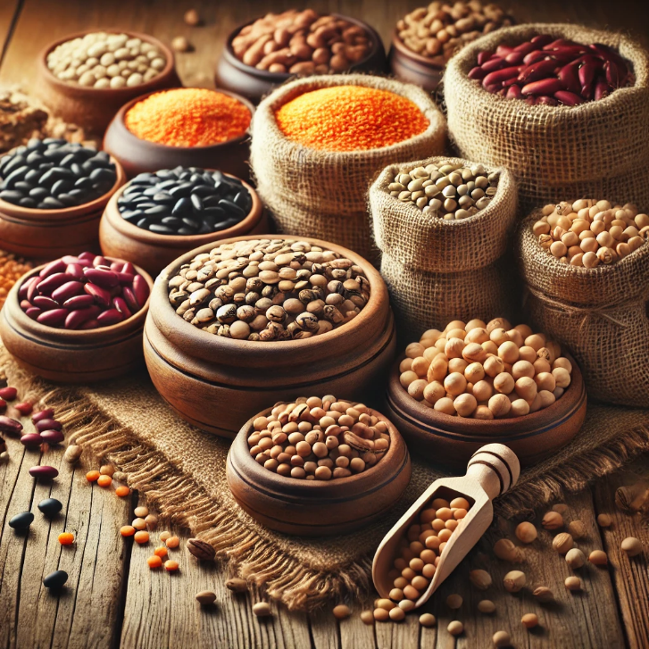
13. Dry Legumes
A Protein-Rich Staple for a Healthy Diet
Dry legumes, also known as pulses, are nutrient-rich seeds harvested from leguminous plants. They are a vital source of plant-based protein, fiber, and essential minerals, making them a staple in many global cuisines. Dry legumes are available in various types and are used in soups, stews, curries, and salads.
Types of Dry Legumes & Their Benefits:
1. Lentils (Masoor, Moong, Toor, Chana, Urad)
Quick-cooking and available in whole or split forms.
High in protein, fiber, and iron.
Used in dal, soups, and stews.
2. Chickpeas (Kabuli Chana, Desi Chana)
Rich in protein and fiber, promoting digestion.
Used in hummus, curries, and salads.
3. Kidney Beans (Rajma)
High in protein and antioxidants.
Common in Indian and Mexican dishes.
4. Black Beans
Rich in fiber, supporting gut health.
Used in Latin American and Asian cuisine.

Slide 26


5. Black-Eyed Peas (Lobia)
High in folate and iron, good for heart health.
Commonly used in curries and stews.
6. Peas (Green & Yellow Split Peas, Whole Peas)
Great for soups and curries.
Rich in protein and essential vitamins.
7. Soybeans
High in protein and used in soy milk, tofu, and tempeh.
Supports muscle health and hormonal balance.
Health Benefits of Dry Legumes
Rich in Protein & Fiber – Supports muscle growth and digestion.
Good for Heart Health – Helps regulate cholesterol levels.
Low in Fat – A healthy alternative to animal protein.
Rich in Vitamins & Minerals – Provides iron, folate, and potassium.
Dry legumes are an essential part of a balanced diet, offering high nutritional value while being budget-friendly and versatile for various dishes.

Slide 27
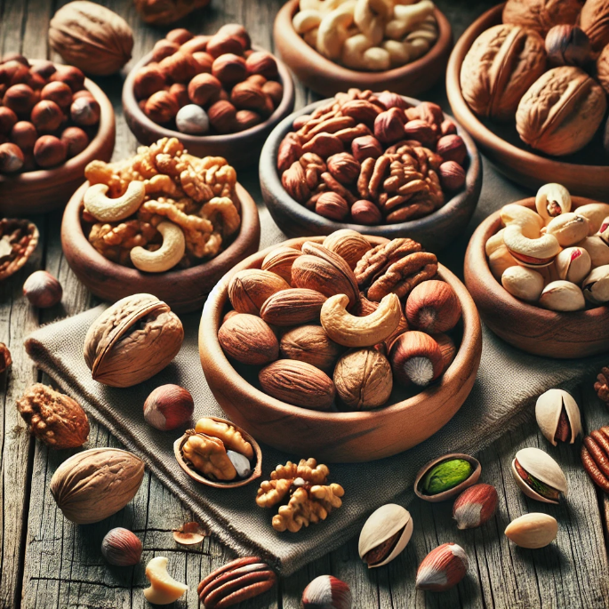
14. Nuts
Nutrient-Dense Superfoods for Health & Energy
Nuts are edible seeds enclosed in hard shells, packed with essential nutrients like healthy fats, protein, fiber, vitamins, and minerals. They are widely consumed as snacks, in cooking, or as ingredients in desserts and health foods. Nuts are known for their heart-healthy benefits and energy-boosting properties.
Types of Nuts:
1. Almonds
Rich in vitamin E, calcium, and antioxidants.
Supports brain health and heart function.
Consumed raw, roasted, or in almond milk and butter.
2. Walnuts
High in omega-3 fatty acids, good for brain health.
Reduces inflammation and supports heart health.
3. Cashews
Creamy texture, rich in healthy fats and minerals.
Used in sweets, gravies, and snacks.
4. Pistachios
High in fiber and protein, promotes weight management.
Eaten roasted or used in desserts and salads.
5. Peanuts
Budget-friendly, high in protein and folate.
Used in peanut butter, snacks, and cooking.

Slide 28
6. Hazelnuts
Rich in antioxidants and vitamin E.
Commonly used in chocolates and spreads like Nutella.
7. Brazil Nuts
High in selenium, good for thyroid health.
Consumed raw or roasted.
8. Macadamia Nuts
Buttery texture, high in monounsaturated fats.
Used in baking and gourmet recipes.
9. Pecans
Rich in antioxidants and heart-healthy fats.
Used in pies, desserts, and salads.
Health Benefits of Nuts
Good for heart health – Reduces bad cholesterol.
Boosts brain function – Especially walnuts and almonds.
Rich in protein & fiber – Aids digestion and muscle health.
Provides healthy fats – Supports skin and hair health.
Nuts are a powerhouse of nutrition and make a great addition to a balanced diet. However, they should be consumed in moderation due to their high calorie content.

Slide 29
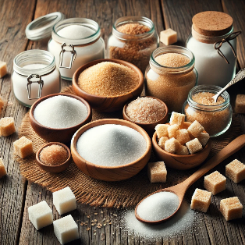

15. Sugar & Jaggery
Natural Sweeteners for Everyday Use
Sugar and jaggery are popular natural sweeteners used in a variety of foods and beverages worldwide. While both provide sweetness, they differ in processing, nutritional content, and health benefits.
1.Sugar
Sugar is a refined carbohydrate extracted from sugarcane
or sugar beets. It is widely used in cooking, baking, beverages.
Types of Sugar:
White Sugar – Highly refined, commonly used in tea, coffee, and desserts.
Brown Sugar – Less refined, contains molasses, adds a caramel flavor.
Powdered Sugar (Icing Sugar) – Finely ground for baking and frosting.
Raw Sugar – Less processed, with a light golden color.
Coconut Sugar – Derived from coconut palm sap, a natural alternative to white sugar.
Uses of Sugar:
Sweetening beverages like tea, coffee, and juices.
Baking cakes, cookies, and confectionery.

Slide 30
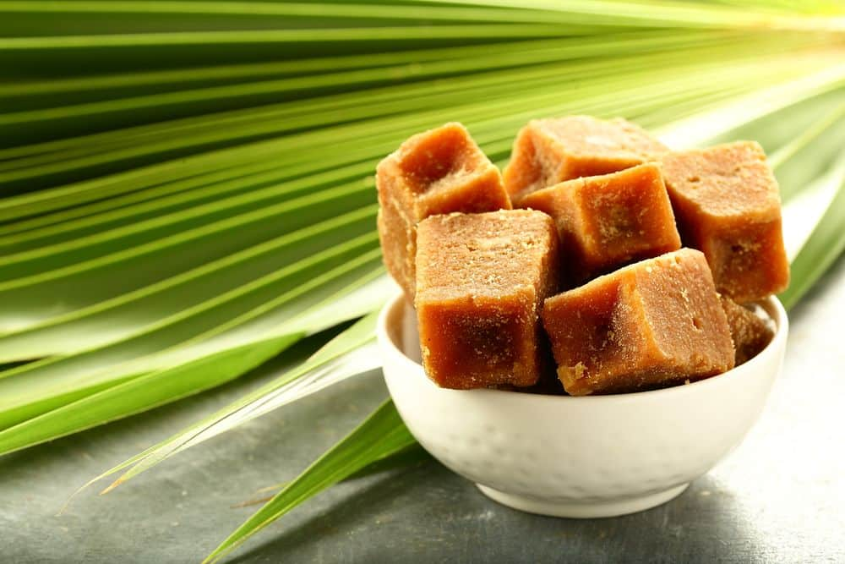

2. Jaggery (Gur)
Jaggery is an unrefined, traditional sweetener made by boiling sugarcane juice or palm sap until it solidifies. It retains natural minerals and is considered a healthier alternative to refined sugar.
Types of Jaggery:
Sugarcane Jaggery – Made from sugarcane juice, commonly used in Indian cooking.
Palm Jaggery – Extracted from palm tree sap, rich in minerals.
Date Palm Jaggery – Known for its deep flavor and high iron content.
Health Benefits of Jaggery:
Rich in Iron & Minerals – Helps prevent anemia.
Boosts Digestion – Aids in detoxifying the liver.
Provides Natural Energy – Slow-release energy without sugar crashes.
Uses of Jaggery:
Used in Indian sweets, desserts, and herbal drinks.
Added to tea, milk, and traditional medicines.
Acts as a natural detoxifier, improving digestion.

Slide 31
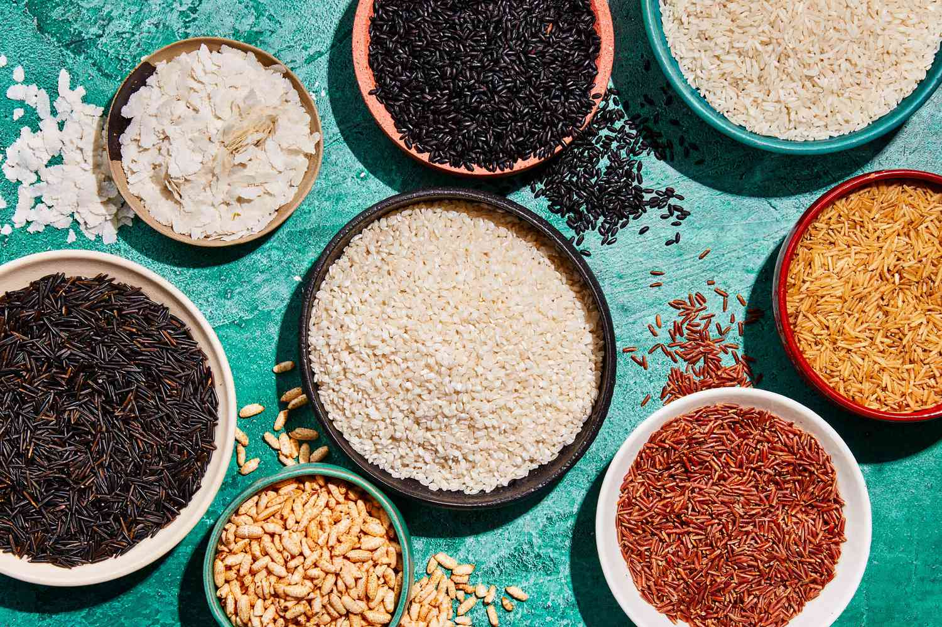
16. Rice & Basmati Rice
1. Rice
Staple Grains for a Balanced Diet
Rice is one of the most widely consumed staple foods in the world, providing energy, essential nutrients, and versatility in cooking. It comes in various types, each offering unique flavors, textures, and nutritional benefits. Rice is a cereal grain that serves as a primary food source for billions of people globally. It is available in different varieties based on grain size, texture, and processing methods.
Types of Rice:
White Rice – Polished and refined, soft texture, easy to digest.
Brown Rice – Whole grain, high in fiber, vitamins, and minerals.
Parboiled Rice – Partially pre-cooked to retain nutrients before milling.
Red Rice – Rich in antioxidants and fiber, has a nutty flavor.
Black Rice (Forbidden Rice) – High in protein, anthocyanins, and antioxidants.

Slide 32
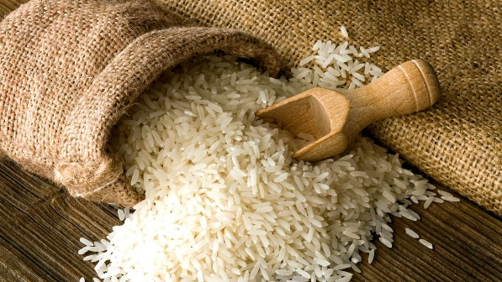

Uses of Rice:
Staple food in Asian, Indian, and Latin American cuisines.
Used in biryanis, pilafs, porridges, and desserts.
Forms the base for sushi, rice noodles, and rice flour products.
Health Benefits of Rice:
Provides Instant Energy – Rich in carbohydrates.
Gluten-Free – Safe for people with gluten intolerance.
Supports Digestion – Brown and whole grain rice aid gut health.

Slide 33
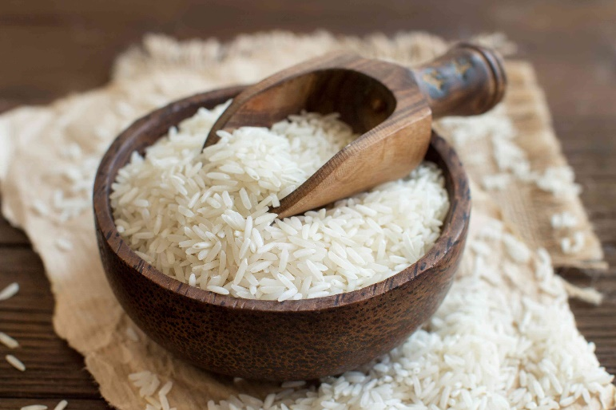

2. Basmati Rice
Basmati rice is a premium long-grain aromatic rice variety known for its distinct fragrance and fluffy texture. It is mainly grown in India and Pakistan and is highly valued in international cuisines.
Features of Basmati Rice:
Long, Slender Grains – Expands and remains separate when cooked.
Fragrant Aroma – Natural scent due to a compound called 2-acetyl-1-pyrroline.
Low Glycemic Index – Better for blood sugar control compared to regular white rice.
Uses of Basmati Rice:
Used in preparing Biryani, Pulao, and festive dishes.
Ideal for Persian, Middle Eastern, and Indian cuisines.
Served as a side with curries, grilled meats, and stews.
Health Benefits of Basmati Rice:
Easier to Digest – Lighter than other rice varieties.
Rich in Fiber (Brown Basmati) – Supports gut health.
Low in Fat & Cholesterol-Free – Heart-friendly food option.

Slide 34
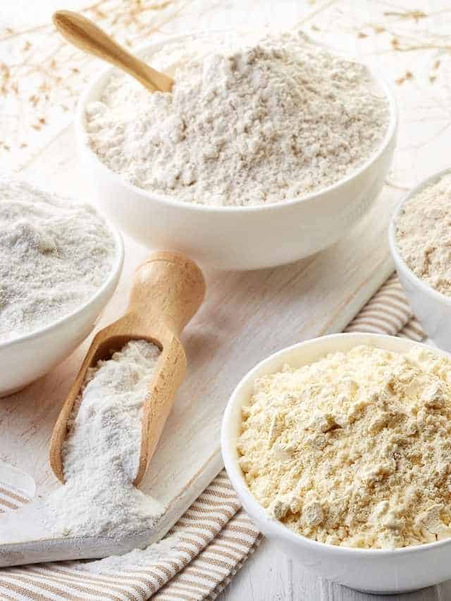
17. Flours
lours are the foundation of countless delicious creations
Flours are finely ground powders made from cereals, legumes, and nuts. They are the key ingredient in baking, cooking, and traditional dishes worldwide.
Types of Flours & Their Uses:
1. Wheat-Based Flours
Whole Wheat Flour (Atta) – Used for chapatis, rotis, and bread.
Refined Wheat Flour (Maida) – Used for cakes, pastries, and pasta.
Semolina (Sooji/Rava) – Coarse flour used in upma, halwa, and pasta.
2. Gluten-Free Flours
Rice Flour – Light and gluten-free, used in South Indian dishes.
Millet Flour (Bajra, Ragi, Jowar) – High in protein and fiber, good for diabetes.
Corn Flour & Cornmeal – Used in soups, sauces, and baking.
3. Protein-Rich Flours
Gram Flour (Besan) – Made from chickpeas, used in pakoras and sweets.
Soya Flour – High in protein, used in health foods.
4. Nut & Seed Flours
Almond Flour – Used in gluten-free and keto baking.
Coconut Flour – Low-carb alternative, rich in fiber.

Slide 35

Health Benefits of Flours:
High in Carbohydrates – Provides essential energy.
Rich in Fiber – Supports digestion and gut health.
Contains Essential Vitamins & Minerals – Good for overall health.
Variety of Gluten-Free Options – Suitable for dietary needs.
flours are indispensable in everyday cooking, providing nutrition and versatility for a wide range of dishes.

Slide 36
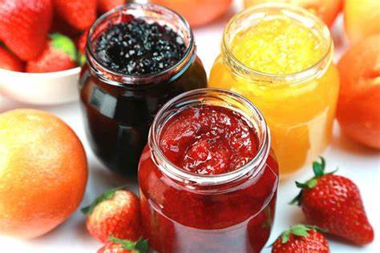

18. Jams & Spreads
Delicious and Versatile Condiments
Jams and spreads are popular food accompaniments made from fruits, nuts, dairy, and other ingredients. They enhance the flavor of bread, toast, pancakes, desserts, and baked goods. These products vary in texture, taste, and nutritional content, making them a staple in many households.
1.Jams
Jams are sweet, thick fruit preserves made by cooking fruit pulp with sugar and pectin. They retain the natural fruit flavor and are commonly used as spreads or fillings.
Types of Jams:
Strawberry Jam – Sweet and tangy, made from fresh strawberries.
Mixed Fruit Jam – A blend of different fruits for a rich flavor.
Mango Jam – Sweet and tropical, made from ripe mangoes.
Pineapple Jam – Tangy and refreshing, perfect for desserts.
Apple Jam – Mildly sweet with a smooth texture.
Health Considerations:
Contains natural fruit but is high in sugar.
Some variants include sugar-free or organic options.
Uses of Jams:
Spread on bread, toast, and bagels.
Used as fillings in cakes, pastries, cookies,
Mixed with yogurt, oatmeal, or milkshakes for added flavor.

Slide 37
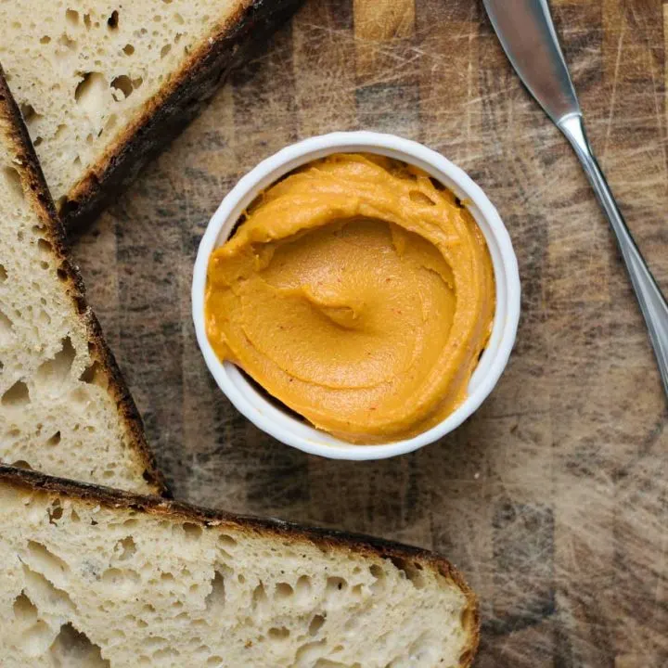
2. Spreads
Spreads come in a variety of flavors and textures, including nut-based, dairy-based, and fruit-based options. They are often used as a topping or filling in snacks and meals.
Types of Spreads:
Nut & Seed-Based Spreads:
Peanut Butter – High in protein and healthy fats, available in creamy or crunchy varieties.
Almond Butter – Rich in vitamins, minerals, and antioxidants.
Hazelnut Spread (Chocolate Spreads) – Sweet and chocolatey, often used in desserts.
Dairy-Based Spreads:
Butter – Made from cream, used for cooking and spreading.
Cheese Spread – A creamy and savory option for sandwiches and snacks.
Fruit-Based & Other Spreads:
Honey Spread – Natural and sweet, a healthy alternative to sugar.
Chocolate & Cocoa Spreads – Popular in desserts and breakfasts.
Uses of Spreads:
Applied to bread, crackers, and pancakes.
Used in baking, smoothies, and desserts.
Nut-based spreads serve as a protein-rich snack option.
Health Benefits & Considerations:
Nut-based spreads provide healthy fats and protein.
Fruit-based jams offer vitamins but can be high in sugar.
Dairy spreads add creaminess but may be high in fat.

Slide 38
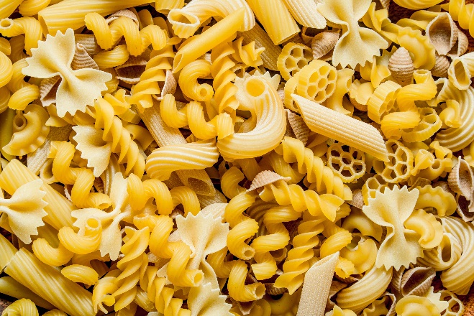
19. Pasta & Noodles
Versatile Staples for Global Cuisines
Pasta and noodles are popular staple foods made from wheat, rice, or other grains. They come in various shapes, sizes, and textures, making them versatile for different culinary styles.
1. Pasta
Pasta is a traditional Italian food made from wheat flour, water, and sometimes eggs. It is available in different shapes and is commonly used in a variety of dishes.
Types of Pasta:
Spaghetti – Long, thin noodles used in classic dishes like spaghetti Bolognese.
Penne – Tube-shaped pasta, ideal for creamy and tomato-based sauces.
Fusilli – Spiral-shaped, holds sauces well.
Macaroni – Small, curved pasta, commonly used in mac and cheese.
Lasagna Sheets – Flat pasta used in layered baked dishes.
Farfalle (Bow-Tie Pasta) – Ideal for salads and creamy sauces.
Uses of Pasta:
Cooked with sauces (tomato, Alfredo, pesto) for main dishes.
Used in pasta salads, soups, and casseroles.
Baked pasta dishes like lasagna and macaroni cheese.
Health Considerations:
Whole wheat or multigrain pasta is healthier due to higher fiber content.
Gluten-free pasta options are available for those with dietary restrictions.

Slide 39
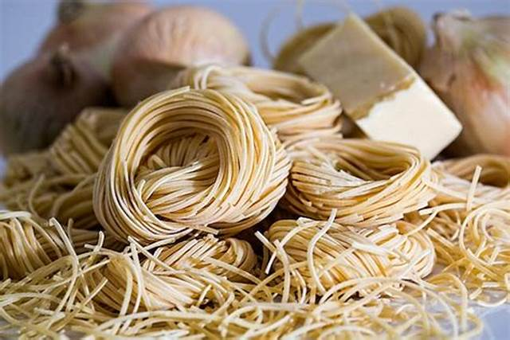
2. Noodles
Noodles are thin, elongated strands of dough, often used in Asian cuisine. They can be made from wheat, rice, or other flours and are available in different textures and thicknesses.
Types of Noodles:
Egg Noodles – Soft and chewy, used in stir-fries and soups.
Rice Noodles – Gluten-free, light, and commonly used in Thai and Vietnamese dishes.
Instant Noodles – Quick-cooking, popular for fast meals.
Soba Noodles – Made from buckwheat, rich in fiber and protein.
Udon Noodles – Thick and chewy, commonly used in Japanese dishes.
Ramen Noodles – Used in ramen soup with broth and toppings.
Uses of Noodles:
Stir-fried with vegetables, sauces, and meats.
Used in soups, broths, and noodle bowls.
Cold noodle salads with soy-based dressings.
Health Considerations:
Whole grain or rice noodles are healthier than refined flour noodles.
Instant noodles are convenient but may contain high sodium and preservatives

Slide 40
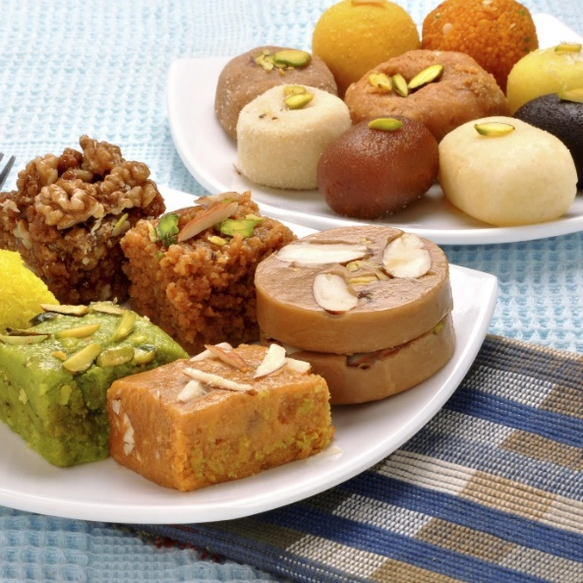
20. Sweets
A Delightful Treat for Every Occasion
Sweets are an essential part of global cuisines, enjoyed during festivals, celebrations, and special occasions. They come in a variety of textures, Flavors, and ingredients, ranging from traditional handcrafted delicacies to modern confections.
Types of Sweets:
1. Traditional Indian Sweets (Mithai)
Gulab Jamun – Soft, deep-fried milk-based balls soaked in sugar syrup.
Rasgulla – Spongy, syrupy cheese dumplings made from chhena (paneer).
Laddu (Ladoo) – Round sweets made from flour, ghee, and sugar.
Jalebi – Crispy, deep-fried spirals soaked in sugar syrup.
Barfi – Fudge-like sweet made from milk solids, sugar, and nuts.
Kaju Katli – Cashew-based diamond-shaped sweet, rich and creamy.
Peda – Sweetened condensed milk fudge, often flavored with saffron or cardamom.
Mysore Pak – A rich, gram flour-based sweet with a buttery texture.
2. Western & Modern Sweets
Cakes & Pastries – Soft, baked desserts made with flour, eggs, sugar, and flavors.
Chocolate & Truffles – Cocoa-based confections, available in milk, dark, and white varieties.
Cookies & Biscuits – Baked sweet treats, crunchy or chewy in texture.
Puddings & Mousses – Creamy, smooth, and flavorful desserts.
Donuts – Fried or baked ring-shaped sweets, topped with glaze or sugar.
Marshmallows – Soft, fluffy, and often used in confectionery.

Slide 41
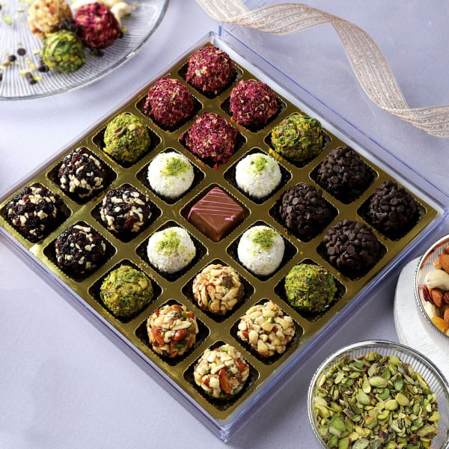

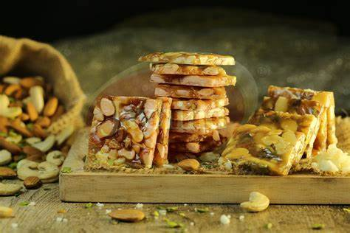
Dry Sweets
Dry Fruit Halwa – Rich sweet made from nuts, ghee, and sugar.
Til Ladoo (Sesame Sweet Balls) – Nutritious laddus made from sesame seeds and jaggery.
Chikki (Peanut & Jaggery Brittle) – Crunchy, energy-packed traditional sweet.
Uses of Sweets:
Celebrations & Festivals – Essential in weddings, religious ceremonies, and festive occasions.
Desserts & Snacks – Served after meals or as a sweet indulgence.
Gifting & Hospitality – Exchanged as gifts and offered to guests.
Health Considerations:
High in Sugar & Calories – Excessive consumption may lead to health issues.
Healthier Alternatives – Sugar-free, jaggery-based, or dry fruit sweets are available.
Homemade vs. Processed Sweets – Freshly made sweets are often healthier than packaged options.
Sweets are an integral part of life, bringing joy and sweetness to every moment, making them irresistible treats worldwide!

Slide 42

21. Snacks
Tasty Bites for Every Craving
Snacks are small portions of food consumed between meals to satisfy hunger or cravings. They come in various Flavors, textures, and ingredients, ranging from traditional homemade treats to modern packaged options.
Types of Snacks:
1. Traditional Indian Snacks
Samosa – Deep-fried pastry filled with spiced potatoes, peas, or meat.
Pakora (Bhajji) – Crispy fritters made from vegetables, coated in gram flour batter.
Chakli/Murukku – Spiral-shaped, crunchy, and deep-fried rice flour snacks.
Sev & Mixture – Spicy, crunchy, and savory fried gram flour noodles mixed with nuts.
Kachori – Flaky, deep-fried snack filled with spicy lentils or peas.
Bhel Puri – A tangy mix of puffed rice, sev, chutneys, and vegetables.
Dhokla – Soft, steamed, fermented snack made from gram flour.
2. Western & Fast-Food Snacks
Chips & Nachos – Crunchy, salty potato or corn chips.
French Fries – Deep-fried potato sticks, popular worldwide.
Popcorn – Light, airy snack, available in buttered, caramel, or spiced flavors.
Sandwiches – Quick, versatile, and filled with veggies, cheese, or meats.
Pizza & Burgers – Fast-food favorites with various toppings and fillings.

Slide 43
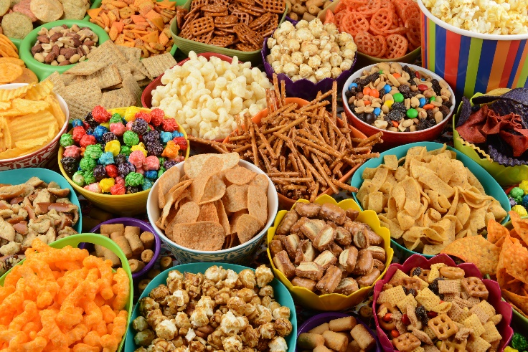

3. Healthy Snacks
Nuts & Seeds – High in protein and healthy fats, a nutritious snack.
Fruits & Yogurt – Natural and refreshing, full of vitamins.
Granola Bars & Energy Bites – Packed with oats, nuts, and natural sweeteners.
Roasted Chickpeas & Makhana (Fox Nuts) – Crunchy, low-calorie, and rich in protein.
4. Baked & Dry Snacks
Biscuits & Cookies – Sweet or savory, available in different flavors.
Khakhra – Thin, crispy whole wheat snack, popular in Gujarat.
Rusk & Toast – Hard, twice-baked bread, usually paired with tea.
Uses of Snacks:
Quick Hunger Fix – Eaten between meals to curb hunger.
Tea-Time Companions – Served with tea or coffee in many cultures.
Travel & On-the-Go – Easy-to-carry options for road trips and picnics.
Party & Festival Treats – Essential in gatherings and celebrations.
Health Considerations:
Deep-Fried vs. Baked Options – Baked snacks are healthier than fried ones.
Portion Control – Overeating processed snacks may lead to weight gain.
Homemade vs. Packaged – Fresh, homemade snacks are often more nutritious.
Snacks add flavour and variety to daily life, making them a favourite among people of all ages!

Slide 44
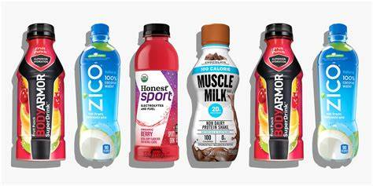
22. Sports, Energy & Protein Drinks
Boosting Hydration & Performance
Sports, energy, and protein drinks are specially formulated beverages designed to replenish energy, enhance athletic performance, and support muscle recovery. Each type serves a unique purpose, catering to different lifestyle and fitness needs.
1. Sports Drinks
Sports drinks are electrolyte-rich beverages that help rehydrate the body, replace lost fluids, and restore essential minerals like sodium, potassium, and magnesium.
Key Benefits:
✔ Replenish electrolytes lost through sweat
✔ Maintain hydration during intense workouts
✔ Provide a quick energy boost
Common Types:
Isotonic Drinks – Balanced fluid and carbohydrate content, ideal for athletes.
Hypotonic Drinks – Low in carbs, quickly absorbed for hydration.
Hypertonic Drinks – High in carbs, used for energy replenishment post-workout.
Popular Brands:
Gatorade, Powerade, Electral, Enerzal

Slide 45
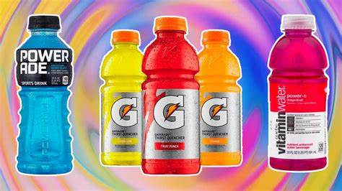
2. Energy Drinks
Energy drinks contain caffeine, sugar, and stimulants to provide instant energy and mental alertness.
Key Benefits:
✔ Boosts energy and reduces fatigue
✔ Enhances concentration and focus
✔ Increases physical endurance
Common Ingredients:
Caffeine – Stimulates the nervous system for increased alertness.
Taurine & B-Vitamins – Support energy metabolism.
Sugars & Artificial Sweeteners – Provide instant energy.
Popular Brands:
Red Bull, Monster, Rockstar, Sting

Slide 46

3. Protein Drinks
Protein drinks help in muscle recovery, weight management, and overall nutrition. These are widely used by athletes, bodybuilders, and fitness enthusiasts.
Key Benefits:
✔ Supports muscle growth and recovery
✔ Provides essential amino acids for strength
✔ Helps in weight management and metabolism
Types of Protein Drinks:
Whey Protein Shakes – Fast-digesting, ideal for post-workout recovery.
Plant-Based Protein Drinks – Made from soy, pea, or almond proteins for vegans.
Casein Protein Shakes – Slow-digesting, best for nighttime recovery.
Meal Replacement Shakes – Nutrient-dense with proteins, carbs, and vitamins.
Popular Brands:
MuscleBlaze, Optimum Nutrition, Amul Protein, Ensure, Herbalife
Health Tip: Always check the ingredient list, as excessive sugar, artificial additives, or caffeine may have side effects. Opt for natural or low-sugar variants for a healthier choice!

Slide 47
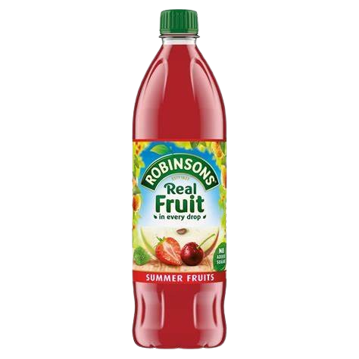

23.Squashes & Cordials
Fresh, vibrant, and packed with goodness
This category includes refreshing fruit-based drinks, purified water, and a variety of condiments that enhance Flavors in cooking.
Squashes and cordials are concentrated fruit syrups that can be diluted with water or soda to create refreshing drinks.
Squashes:
Squashes are sweetened fruit syrups with added preservatives. They are commonly mixed with cold water or soda.
✔ Made from fruits like: Orange, Lemon, Mango, Pineapple, and Mixed Fruit
✔ Best served: Diluted with water or club soda
✔ Popular Brands: Kissan, Rasna, Mapro
Cordials:
Cordials are concentrated fruit or herbal syrups, sometimes infused with medicinal ingredients. They are used as flavouring agents in cocktails or mocktails.
✔ Examples: Lime Cordial, Blackcurrant Cordial
✔ Uses: Mix with soda, cocktails, or desserts

Slide 48

24. Packaged Water
Packaged drinking water ensures safe and purified hydration, available in different types:
Types of Packaged Water:
Mineral Water – Naturally enriched with essential minerals.
Purified Water – Processed through filtration, reverse osmosis, or UV treatment.
Spring Water – Sourced from natural underground springs.
Flavored Water – Infused with fruit flavors for a refreshing taste.
✔ Popular Brands: Bisleri, Aquafina, Kinley, Himalaya
💧 Health Tip: Always check for the ISI or FSSAI certification to ensure safety and purity.

Slide 49
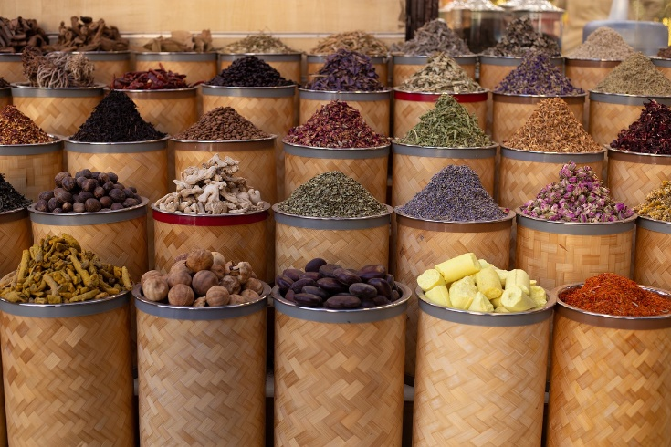
25. Condiments
Essential Beverages & Flavour Enhancers
Vinegars & Pickles
White Vinegar – Used in cooking and pickling.
Apple Cider Vinegar – Known for its health benefits.
Pickles (Achar) – Spiced, fermented vegetables or fruits preserved in oil or vinegar.
Dry Condiments & Seasonings
Salt & Pepper – Basic seasonings for all cuisines.
Chaat Masala & Garam Masala – Indian spice blends for flavor enhancement.
Herbs (Oregano, Basil, Thyme, Rosemary) – Used in Italian, Mediterranean, and continental dishes.
✔ Uses of Condiments:
✔ Adds depth and flavor to food
✔ Used as a side dip or ingredient in cooking
✔ Enhances taste in fast foods, snacks, and traditional dishes
Final Thoughts:
✔ For Refreshing Drinks → Squashes & Cordials
✔ For Safe Hydration → Packaged Water
✔ For Flavorful Cooking → Condiments
Each of these plays a crucial role in everyday meals and beverages, making food tastier and hydration healthier!

Slide 50
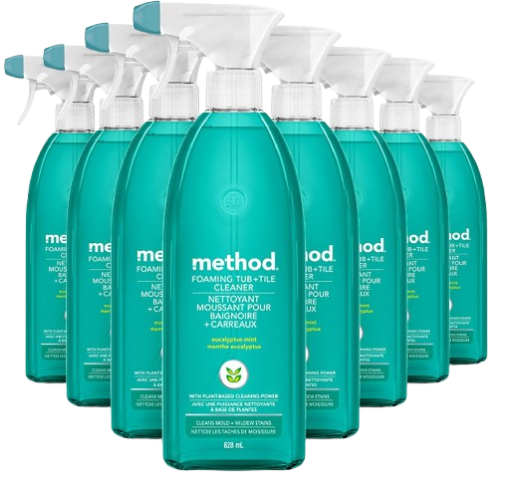
Household Items
Essential Products for Everyday Living
Household items are essential products used for cleaning, maintenance, cooking, and personal care, ensuring a comfortable and hygienic living environment.
1. Cleaning & Hygiene Products
Keeping a home clean and hygienic is essential for a healthy lifestyle.
✔ Surface Cleaners – Used for floors, kitchen counters, and furniture (e.g., Dettol, Lizol, Colin).
✔ Dishwashing Liquids & Bars – Help remove grease and stains from utensils (e.g., Vim, Pril).
✔ Laundry Detergents & Fabric Softeners – Used for washing clothes (e.g., Surf Excel, Tide, Comfort).
✔ Toilet Cleaners – Disinfects and cleans toilets (e.g., Harpic, Domex).
✔ Garbage Bags & Dustbins – Essential for proper waste disposal.
2. Kitchen Essentials
Every kitchen needs basic utensils, storage solutions, and appliances for smooth functioning.
✔ Cookware & Utensils – Pots, pans, spatulas, ladles, pressure cookers.
✔ Storage Containers – Airtight jars for storing grains, spices, and snacks.
✔ Foil, Cling Wrap & Baking Paper – Used for food storage and baking.
✔ Chopping Boards & Knives – Essential for food preparation.
✔ Kitchen Towels & Napkins – Used for wiping and cleaning surfacees.

Slide 51
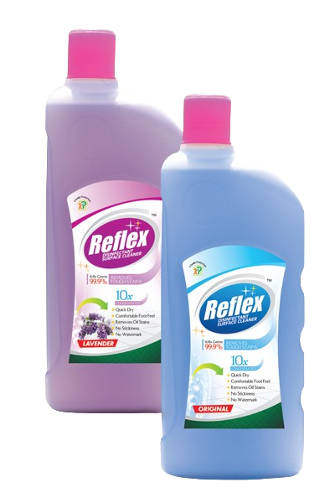
3. Home Utility Items
✔ Lighting & Electricals – LED bulbs, extension cords, batteries.
✔ Furniture & Decor – Chairs, tables, curtains, bedsheets, cushion covers.
✔ Repair & Maintenance Tools – Screwdrivers, pliers, hammers, tapes.
4. Personal Care & Toiletries
✔ Soaps & Body Wash – Cleanses and refreshes the skin (e.g., Lux, Dove).
✔ Shampoos & Conditioners – Keeps hair clean and healthy (e.g., Head & Shoulders, Pantene).
✔ Toothpaste & Brushes – Essential for oral hygiene (e.g., Colgate, Sensodyne).
✔ Hand Sanitizers & Tissues – Helps maintain personal hygiene.
5. Storage & Organizers
✔ Shelves & Racks – Helps keep spaces clutter-free.
✔ Plastic Bins & Boxes – Used for organizing clothes, accessories, and documents.
✔ Shoe Racks & Hangers – Keeps footwear and clothes neatly arranged.
6. Air Fresheners & Pest Control
✔ Room Fresheners & Diffusers – Keeps the home smelling pleasant.
✔ Mosquito Repellents & Insect Killers – Helps keep pests away (e.g., All Out, Good Knight).
Final Thoughts
✔ For Cleaning & Hygiene → Surface cleaners, dishwashers, detergents
✔ For Kitchen & Cooking → Utensils, storage, and food wraps
✔ For Home Comfort → Lighting, furniture, and organizers
✔ For Personal Care → Toiletries and grooming essentials
Household items play a crucial role in maintaining cleanliness, organization, and a comfortable lifestyle, making them a necessity in every home!

Slide 52

Skin & Health Care
Essential Products for Wellness & Personal Care
Skin and health care products help maintain hygiene, nourishment, and overall well-being. They include skincare essentials, healthcare products, and hygiene solutions to keep the body healthy and glowing.
1. Skin Care Products
Skincare products help protect, nourish, and enhance skin health, catering to different skin types and concerns.
a) Cleansers & Face Wash
✔ Removes dirt, oil, and impurities from the skin.
✔ Types: Gel-based, foaming, cream-based, micellar water.
✔ Popular Brands: Cetaphil, Neutrogena, Himalaya, Nivea.
b) Moisturizers & Creams
✔ Keeps skin hydrated and soft.
✔ Types: Oil-based for dry skin, water-based for oily skin, anti-aging creams.
✔ Popular Brands: Ponds, Olay, Lakmé, Vaseline.

Slide 53
c) Sunscreens & Serums
✔ Protects from harmful UV rays and prevents skin damage.
✔ Vitamin C & Hyaluronic Acid serums for glowing skin.
✔ Popular Brands: Lotus, Biotique, La Roche-Posay, The Ordinary.
d) Face Masks & Scrubs
✔ Exfoliates dead skin cells and improves skin texture.
✔ Clay masks, charcoal masks, fruit-based masks.
✔ Popular Brands: Mamaearth, The Body Shop, Plum.
2. Health Care & Hygiene Products
These products help in maintaining daily hygiene and boosting overall health.
a) Oral Care
✔ Toothpaste, toothbrushes, mouthwash, and dental floss for strong teeth and fresh breath.
✔ Popular Brands: Colgate, Sensodyne, Listerine.
b) Body Care & Hygiene
✔ Soaps, body washes, deodorants, and talcum powders for freshness and hygiene.
✔ Popular Brands: Lux, Dove, Nivea, Rexona.
c) Hair Care
✔ Shampoos, conditioners, hair oils, and serums for healthy hair.
✔ Popular Brands: Pantene, L’Oréal, Indulekha, Head & Shoulders.

Slide 54
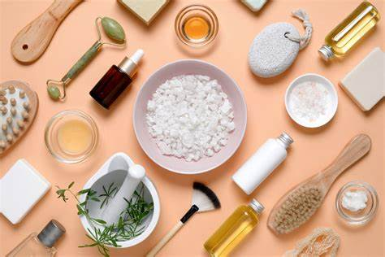

d) Feminine Hygiene
✔ Sanitary pads, tampons, menstrual cups for comfort and hygiene.
✔ Popular Brands: Whisper, Stayfree, Sofy, Sirona.
e) First-Aid & Medical Supplies
✔ Bandages, antiseptics, pain relievers, multivitamins, and thermometers for basic health care.
✔ Popular Brands: Dettol, Savlon, Crocin, Revital.
3. Health & Wellness Supplements
✔ Multivitamins & Proteins – For immunity and muscle growth.
✔ Ayurvedic & Herbal Remedies – Natural solutions for wellness.
✔ Immunity Boosters – Chyawanprash, Vitamin C, Zinc supplements.
✔ Popular Brands: Dabur, Himalaya, Patanjali, Ensure.
Taking care of skin and health is essential for a confident, healthy, and active lifestyle!

Slide 55

Cutlery
Essential Dining & Kitchen Tools
Cutlery refers to hand-held tools used for eating, serving, and preparing food. It includes various utensils made from stainless steel, silver, plastic, or bamboo, designed for convenience and elegance in dining and cooking.
Types of Cutlery
a) Eating Cutlery
✔ Spoons – Used for soups, desserts, rice, and general dining.
Teaspoon, Tablespoon ,Dessert Spoon , Forks, Dinner Fork ,Salad Fork, Dessert Fork
✔ Knives – Used for cutting and spreading food.
Dinner Knife ,Butter Knife ,Steak Knife ,
b) Serving Cutlery
✔ Serving Spoon & Fork ✔ Ladles ,Tongs
✔ Cake & Pie Servers

Slide 56
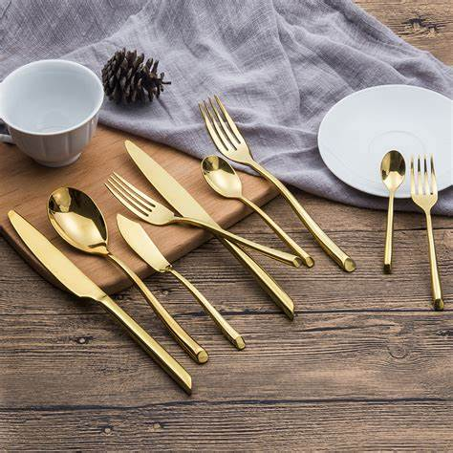

c) Cooking Cutlery
✔ Chef’s Knife – A multi-purpose knife for chopping, slicing, and dicing.
✔ Paring Knife – A small knife for peeling and fine cutting.
✔ Cleaver – A heavy knife for cutting through bones and thick food items.
✔ Peeler – Used for peeling fruits and vegetables.
✔ Whisk & Spatula – For mixing, flipping, and cooking food.
2. Materials of Cutlery
✔ Stainless Steel – Durable, rust-resistant, and widely used.
✔ Silver Cutlery – Elegant and luxurious, often used in fine dining.
✔ Plastic & Disposable Cutlery – Lightweight and convenient for events.
✔ Bamboo & Wooden Cutlery – Eco-friendly and biodegradable.
3. Importance of Quality Cutlery
✔ Enhances dining experience with proper functionality.
✔ Adds elegance to table settings and food presentation.
✔ Essential for efficient cooking and serving.
✔ Available in various designs for everyday use and special occasions.
Cutlery is an integral part of both everyday dining and professional kitchen setups. Choosing the right type enhances comfort, ease, and aesthetics while eating, serving, and preparing food.

Slide 57

Schools & Office Stationery Supplies
Educational and professional settings
These items are essential for education, professional use, and organization.
✔ Notebooks & Writing Pads – Spiral-bound, ruled, and unruled notebooks.
✔ Pens, Pencils & Markers – Gel pens, ballpoint pens, highlighters, and sketch pens.
✔ Folders & Files – Document organizers for office and school use.
✔ Sticky Notes & Labels – For reminders and efficient task management.
✔ Art & Craft Supplies – Paints, crayons, sketchbooks, brushes, and scissors.
✔ Staplers, Punching Machines & Clips – Essential office tools for paperwork.

Slide 58

Tissues & Rolls
Providing comfort in daily use
These products provide convenience for hygiene and cleanliness.
✔ Facial Tissues – Soft tissues for personal use.
✔ Toilet Rolls – Essential for bathrooms and hygiene.
✔ Kitchen Towels – Absorbent paper towels for cleaning spills.
✔ Wet Wipes & Sanitizing Wipes – Used for skin cleansing and disinfection.

Slide 59


Toys & Handicrafts
Inspire creativity, encourage learning, and bring joy to Kids
This category includes entertainment for kids and traditional handmade items.
a) Toys
✔ Soft Toys & Plushies – Stuffed animals, teddy bears, and cartoon characters.
✔ Educational Toys – Puzzles, blocks, STEM kits for learning.
✔ Outdoor & Sports Toys – Bicycles, skipping ropes, and cricket sets.
✔ Electronic & Remote-Controlled Toys – Drones, cars, and robotic kits.
b) Handicrafts
✔ Wooden Carvings & Paintings – Handmade decorative pieces.
✔ Clay & Terracotta Art – Pots, sculptures, and figurines.
✔ Jewelry & Fabric Handicrafts – Traditional handmade accessories and embroidered fabrics.

Slide 60

Baby Care Items & Apparels
health, comfort, and well-being of infants
Baby care products ensure the comfort and safety of infants.
✔ Diapers & Wipes – Disposable and cloth diapers for hygiene.
✔ Baby Skincare & Bathing Products – Gentle soaps, lotions, and shampoos.
✔ Baby Feeding Bottles & Accessories – BPA-free bottles, sippers, and sterilizers.
✔ Clothing & Footwear – Soft cotton onesies, mittens, and shoes.
✔ Baby Bedding & Blankets – Soft and cozy bedding for restful sleep.

Slide 61


Pets & Animal Care Items
Pets are beloved animals that bring joy
Pets need proper care and nutrition for a healthy life.
✔ Pet Food & Treats – Nutritious food for dogs, cats, birds, and fish.
✔ Grooming Products – Shampoos, brushes, and nail clippers for pet hygiene.
✔ Pet Accessories – Collars, leashes, cages, and pet beds.
✔ Pet Health Supplements – Vitamins, deworming medicines, and flea control products.
✔ Toys & Chewing Bones – For mental stimulation and fun.
Final Thoughts
✔ For Celebrations → Party Decorations & Gifts
✔ For School & Office → Stationery Supplies
✔ For Hygiene → Tissues & Rolls
✔ For Kids → Toys & Handicrafts
✔ For Babies → Baby Care & Clothing
✔ For Pets → Food, Grooming & Accessories

Slide 62



Ramprasad GVSS.,
Founder & MD.,
📞 +91 7386112277,
✉️ Email: cmd@motherindgroup.com | ramprawsadindia@gmail.com
🌐 Website: www.motherindiagroup.com

